Slide 1
Is Entropy that Important?
YES!
1

Slide 2
Any source of information
Source
coder
Channel
coder
Channel
Source
Channel
Channel
decoder
Source
decoder
Sink,
receiver

Slide 3
Change to an efficient representation,
i.e., data compression.
Source
coder
Channel
coder
Channel
Source
Channel
Channel
decoder
Source
decoder
Sink,
receiver

Slide 4
Change to an efficient representation for,
transmission, i.e., error control coding.
Source
coder
Channel
coder
Channel
Source
Channel
Channel
decoder
Source
decoder
Sink,
receiver

Slide 5
Source
coder
Channel
coder
Channel
Source
Channel
Channel
decoder
Source
decoder
Sink,
receiver
Recover from channel distortion.

Slide 6
Source
coder
Channel
coder
Channel
Source
Channel
Channel
decoder
Source
decoder
Sink,
receiver
Reconstruct the source

Slide 7
Source
coder
Channel
coder
Channel
Source
Channel
Channel
decoder
Source
decoder
Sink,
receiver
The channel is anything transmitting or storing information –
a radio link, a cable, a disk, a CD, a piece of paper, …

Slide 8
Fundamental Entities
H
R
Source
coder
Channel
coder
Channel
C
Source
Channel
Channel
decoder
Source
decoder
Sink,
receiver
C
H: The information content of the source.
R: Rate from the source coder.
C: Channel capacity.

Slide 9
Fundamental Theorems
H
R
Source
coder
Channel
coder
Channel
C
Source
Channel
Channel
decoder
Source
decoder
Sink,
receiver
C
Shannon 1: Error-free transmission possible if R$≥$H and C $≥$R.
Source coding theorem (simplified)
Channel coding theorem (simplified)

Slide 10
Key concept in data compression
“Data compression can be achieved by assigning short descriptions to the most frequent outcomes of the data source, and necessarily longer descriptions to the less frequent outcomes.” – Thomas & Cover
Why?

Slide 11
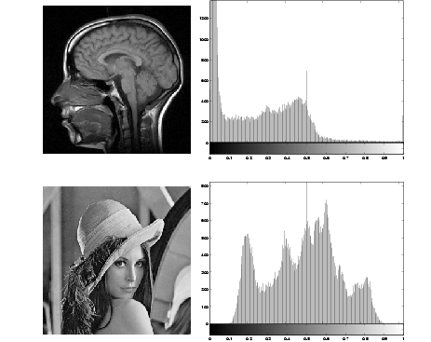
Coding Redundancy
Some things are more common than others:

Slide 12
Short words are common
Short representations for common things, and long representations for uncommon
This concept is already familiar in many ways
The 19 most common words in the English language are:
the, of, are, I, and, you, a, can, to, he,
her, that, in, was, is, has, it, him, his

Slide 13
Long words are uncommon
Very long words are generally very uncommon:
  Antidisestablishmentarianism
  Floccipoccinihilipilification
  Pneumonoultramicroscopicsilicovolcanicconiosis

Slide 14
Morse Code – Common Letters
Letter | Frequency per 1000 in English | International Morse Code
E | 130 | .
T | 93 | _
N | 78 | _ .
R | 77 | ._.
I | 74 | ..

Slide 15
Morse Code – Uncommon Letters
Letter | Frequency per 1000 English | International Morse Code
X | 5 | _.._
K | 3 | _._
Q | 3 | _ _._
J | 2 | ._ _ _
Z | 1 | _ _..

Slide 16

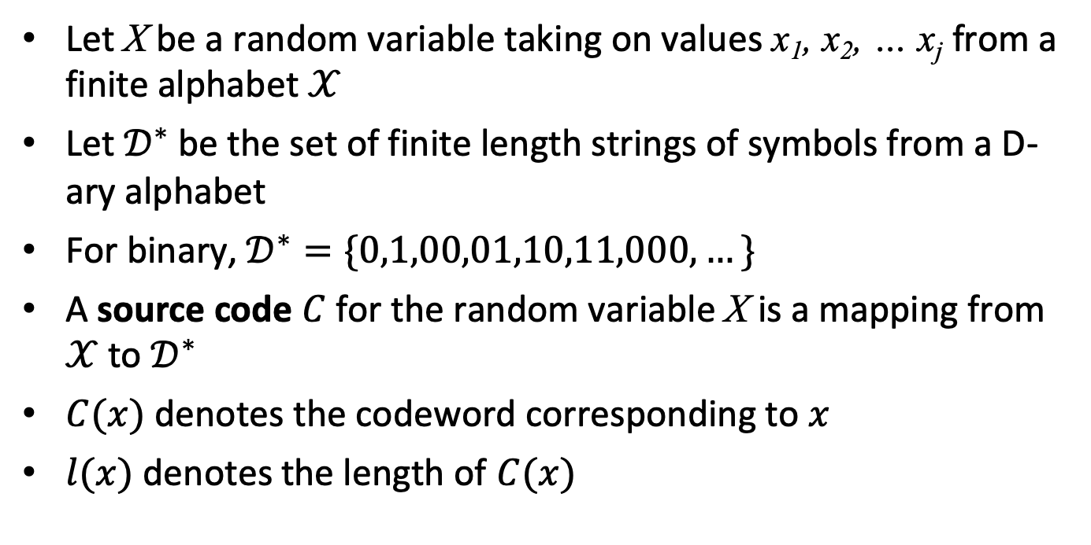


Source Coding
$𝒳$:{x₁, x₂, … x_{j} }
$𝒟$:{0, 1, 00, 01, 10, 11, 000, …}
X
Source coding
$$𝒟^{∗}$$
Let X be a random variable taking on values x₁, x₂, … x_{j} from a finite alphabet $𝒳$
Let $𝒟^{∗}$ be the set of finite length strings of symbols from a D-ary alphabet
For binary, $𝒟^{∗}=\{0,1,00,01,10,11,000,…\}$
A source code $C$for the random variable X is a mapping from $𝒳$to $𝒟^{∗}$
$C(x)$ denotes the codeword corresponding to $x$
$l(x)$denotes the length of $C(x)$
16

Slide 17
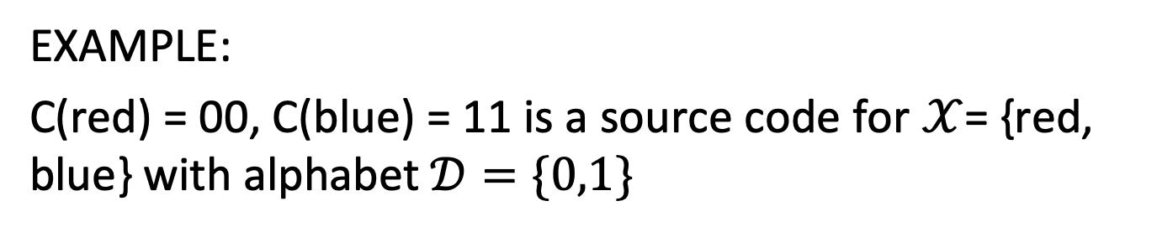
Source Coding
EXAMPLE:
C(red) = 00, C(blue) = 11 is a source code for $𝒳$= {red, blue} with alphabet$𝒟=\{0,1\}$

Slide 18
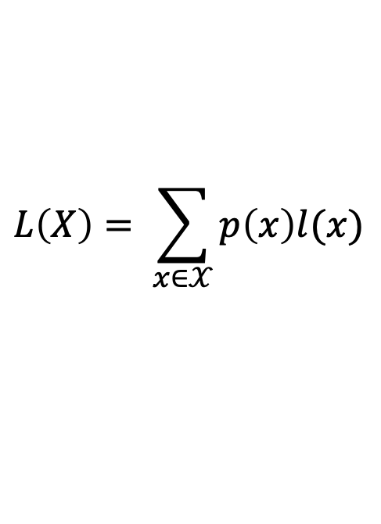
Expected Length
The expected length of the code is:
ASCII is a fixed-length code (FLC)
a → 10000011 and A → 10000001
The same number of bits (7) is used to represent each symbol
$$L\left(X\right)= \sum_{x∈𝒳}{p\left(x\right)l(x)}$$

Slide 19
Variable Length Coding
If we want to reduce the number of bits required to represent different messages, we should use different numbers of bits to represent different symbols
Use fewer bits for things that occur more often
This would be a variable length code (VLC)

Slide 20
Examples of Codes
Input letter | Prob. | Code 1 | Code 2 | Code 3 | Code 4
A | 1/2 | 0 | 0 | 1 | 0
B | 1/4 | 0 | 1 | 01 | 01
C | 1/8 | 1 | 00 | 001 | 011
D | 1/8 | 10 | 11 | 000 | 0111
L(C) |  | 1.125 | 1.25 | 1.75 | 1.875

Slide 21
Problems with these codes
Code 1: Two input symbols have the same codeword
Code 2: This problem is fixed. But suppose the decoder receives 00. What was the input? C or AA?
Codes 3 and 4 look OK. Code 3 is shorter.
Is that the best we can do?

Slide 22
Thank You

